Slide 1




NEXT GEN EMPLOYABILITY PROGRAM
Creating a future-ready workforce
Team Members
College Name
Student Name : Alliraj P
Student ID : 623521104002
6235 - AVS College of Technology

Slide 2

CAPSTONE PROJECT SHOWCASE
Project Title
Building Bus Reservation System using Python and Django
Abstract | Problem Statement | Project Overview | Proposed Solution | Technology Used | Modelling & Results | Conclusion

Slide 3
Abstract
The Bus Reservation System Website helps people book bus tickets online easily.
It's made by HTML, CSS, and Django making it simple to use.
You can look for buses by where you want to go, when you want to leave, and what type of bus you prefer.
If your plans change, you can also cancel your booking easily.
When you find the right bus, you can choose how many seats you need and book them.
Source :

Slide 4
Problem Statement
In today's busy world, buying bus tickets can be hard and take a lot of time.
The old way of getting tickets usually means waiting in long lines, filling out forms by hand, and it's not always easy to find a place to do it.
Plus, there's no one place where you can easily book and handle all your bus tickets, which causes problems for both the people buying tickets and the companies running the buses.
Source :

Slide 5
Project Overview
This system should provide a seamless online platform for customers to search, book, and manage bus tickets conveniently.
Develop the system using modern technologies like Django, HTML, CSS, and SQLite.
This makes it possible to create a website that's easy to use, reliable, and secure.
It'll be more convenient, faster, and safer for everyone involved.
Source :

Slide 6
Proposed Solution
User Registration and Authentication
Bus Search and Booking
Real-time Information Updates
Seat Selection
Booking Confirmation
Cancelletion
Source :

Slide 7


Technology Used
Front-end
Back-end
Source :

Slide 8
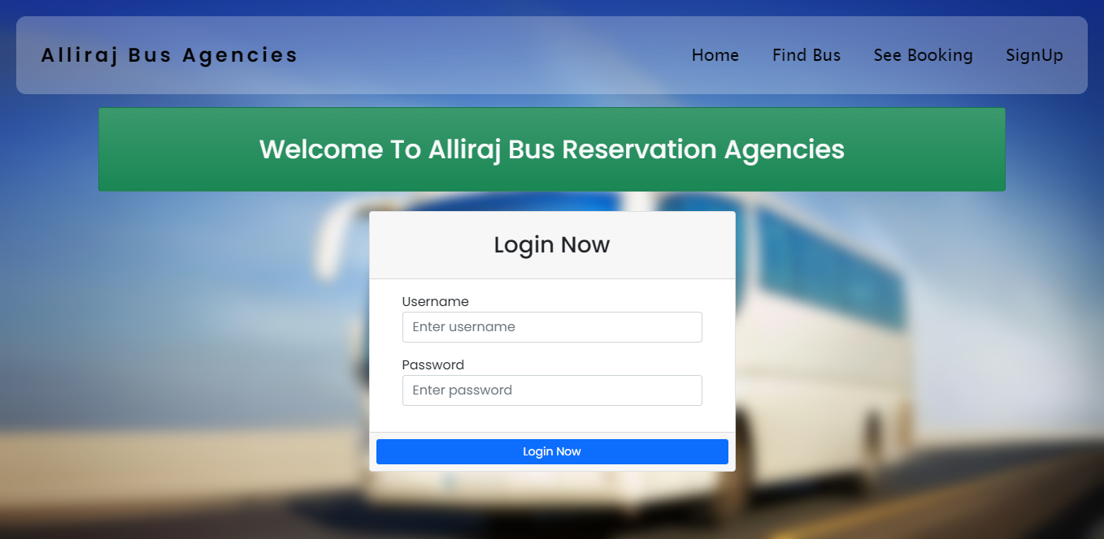
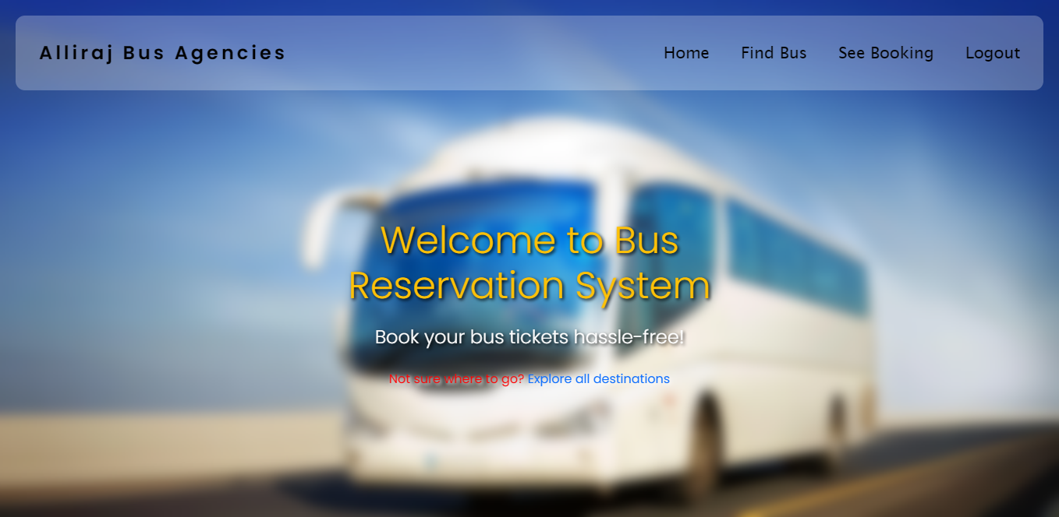
Modelling & Results
Landing page with login form
Home Page
Source :

Slide 9
Homepage

Slide 10
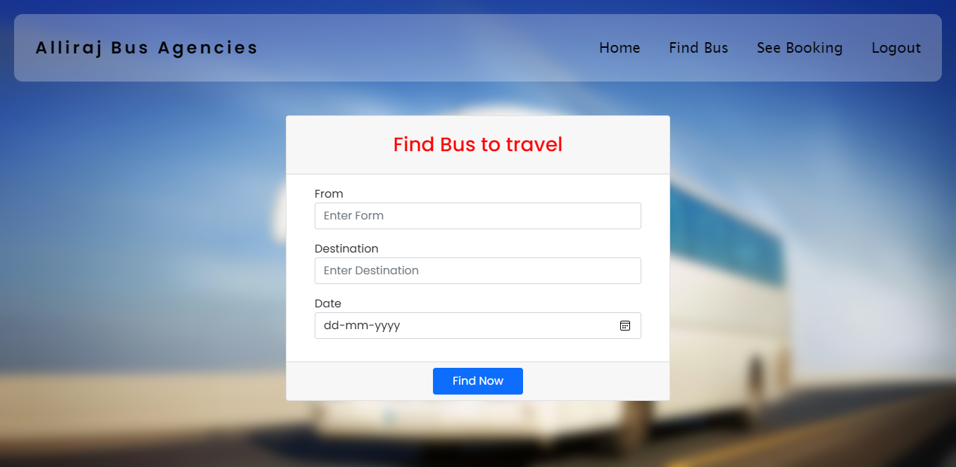
Find Bus Page

Slide 11
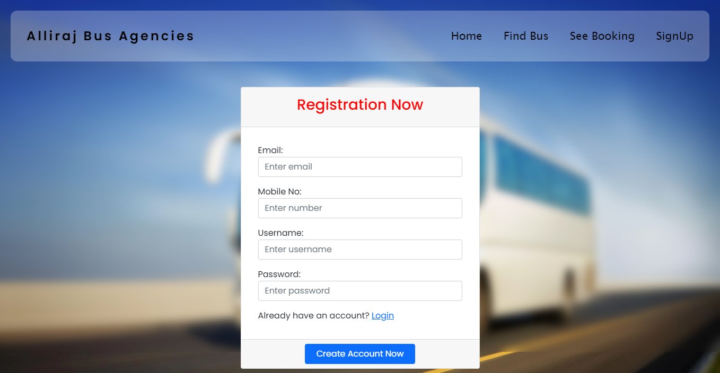
Registration Page

Slide 12
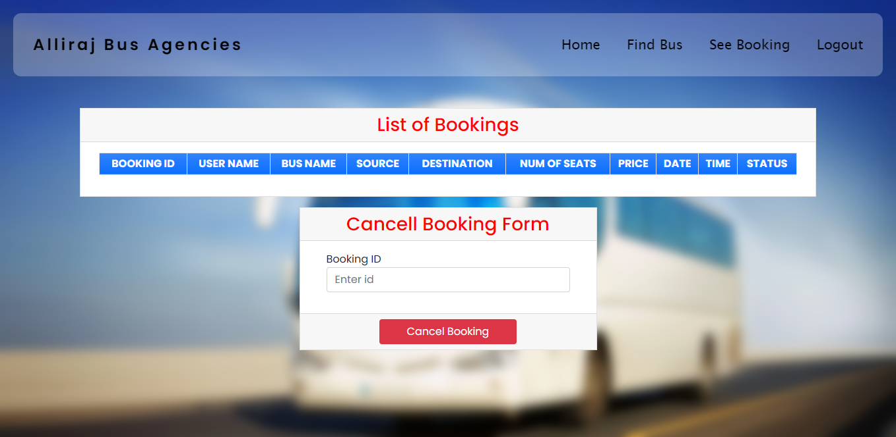
List of Busses Page

Slide 13
Future Enhancements:
Secure Payment Options
Administrative Tools
Language Translation Services
Smart Ticket Verification
Compliance raise system

Slide 14
Conclusion
Our Bus Reservation System Website is poised to transform the way bus tickets are booked and managed, offering a seamless and efficient booking experience while improving accessibility, convenience, and security.
Source :

Slide 15
Thank You!
Notes:
Thank You !!

